Slide 1

Automatic Question Generator in NLP
Rao Trishali-41
Rebello Lincy-42
Mohmmad Yasir Khan-43
Shaikh Wahid-44
Date of presentation: 28/07/2022
Under the guidance of: Dr. Nitika Rai
St. Francis Institute of Technology
Department of Information Technology

Slide 2

Content
Introduction
Review of Literature
Research Gaps Identified
Problem Definition & Objectives
Proposed Solution
Scope of Project
System Description
Architecture or block diagram (broader topic/algorithm)
Explanation of individual blocks (if exists) or algorithm
Hardware & Software Requirements

Slide 3
Introduction
Question generation has a lot of use cases with the most prominent one being the ability to generate quick assessments from any given content. It would help to assess any instructors in generating information/data. Question answering (QA) is a computer science discipline within the fields of information retrieval and natural language processing (NLP), which is concerned with building systems that generates questions from the given context posed by humans in a natural language. Moreover, we would be focusing on the remembering and Analyzing level of Bloom’s Taxonomy.

Slide 4
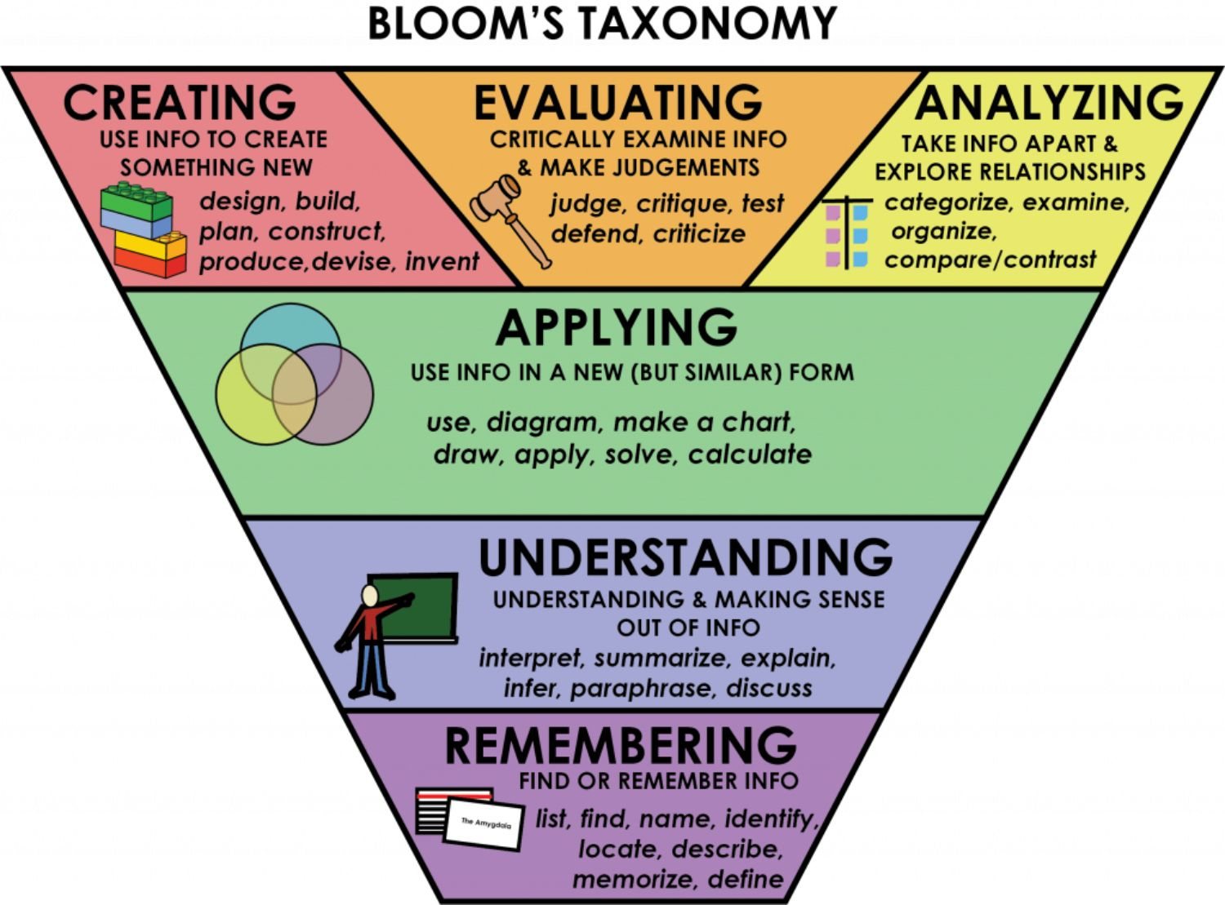
Introduction

Slide 5
Review of Literature
Simplifying Paragraph-level Question Generation via Transformer Language Models
Used a simple single Transformer-based question generation model it is also evaluated on BLEU 4 and ROUGE L metrics. It is trained on the question generation model on version 1.1 of the Stanford Question Answering Dataset (SQuAD)

Slide 6
Review of Literature
2. Automatic Fill-the-blank Question Generator for Student Self-assessment:
proposed automatic question generation system for student self-assessment by leveraging . The immediate advantage is to quickly generate and edit questions for pop quizzes and worksheets from their lecture notes.
They have used 3 parts to generate question
1) Sentence Selection: Selecting coherent and important sentences from the text to ask about
2) Gap Selection: Identifying which part of the resulting sentence to choose as the gap. The gap essentially represents the concept being tested
3) Distractor Selection: Crafting effective distractors to be part of the set of options to confuse the learner to ensure that he has a good grasp of the concept being tested

Slide 7
Review of Literature
3. Paragraph-level Neural Question Generation
A neural network approach that incorporates coreference knowledge via a novel gating mechanism. Compared to models that only take into account sentence-level information.
To harvest high quality question answer pairs from the paragraphs of an article of interest. In the task formulation, which consists of two steps: candidate answer extraction and answer-specific question generation. Given an input paragraph,
first identify a set of question-worthy candidate answers ans = (ans1, ans2, ..., ansl), each a span of text . For each candidate answer ansi , we then aim to generate a question Q — a sequence of tokens y1, ..., yN — based on the sentence S that contains candidate ansi such that:
• Q asks about an aspect of ansi that is of potential interest to a human;
• Q might rely on information from sentences that precede S in the paragraph.
Notes:
A Gated Recurrent Unit (GRU), as its name suggests, is a variant of the RNN architecture, and uses gating mechanisms to control and manage the flow of information between cells in the neural network.
The structure of the GRU allows it to adaptively capture dependencies from large sequences of data without discarding information from earlier parts of the sequence. This is achieved through its gating units, similar to the ones in LSTMs, which solve the vanishing/exploding gradient problem of traditional RNNs. These gates are responsible for regulating the information to be kept or discarded at each time step.
The ability of the GRU to hold on to long-term dependencies or memory stems from the computations within the GRU cell to produce the hidden state. While LSTMs have two different states passed between the cells — the cell state and hidden state, which carry the long and short-term memory, respectively — GRUs only have one hidden state transferred between time steps. This hidden state is able to hold both the long-term and short-term dependencies at the same time due to the gating mechanisms and computations that the hidden state and input data go through.
The GRU cell contains only two gates: the Update gate and the Reset gate. Just like the gates in LSTMs, these gates in the GRU are trained to selectively filter out any irrelevant information while keeping what’s useful. These gates are essentially vectors containing values between 0 to 1 which will be multiplied with the input data and/or hidden state. A 0 value in the gate vectors indicates that the corresponding data in the input or hidden state is unimportant and will, therefore, return as a zero. On the other hand, a 1 value in the gate vector means that the corresponding data is important and will be used.

Slide 8
Review of Literature
4.Neural Question Generation for Reading Comprehension
Incorporated SQuAD dataset wherein the questions are posed by crowd workers and are of relatively high quality. Used the sequence-to-sequence approach.
Then investigated the models using RNN encoder-decoder architecture.
For training and inferencing/predicting the output, they have used beam search.
In implementations, they have blended the model in Torch7 with OpenNMT.
Compared to different Baselines like IR, Seq2seq, H&S, etc. with packages/systems viz. Bleu1-4, Meteor, and Rogue. The resulting model could generate better quality questions than the H & S system.

Slide 9
Gap Analysis
In [1], The drawbacks are they have very low BLEU 4 and ROUGE L score.
In [2], Question Variety , a few students noted that there were repetitive questions tested on the same key concept.
In [3], The Main limitation is that their scores of BLEU 4, METEOR and ROUGE L are very low.
In [4]The flaw in the model is that it only encodes sentence-level information and achieves the best performance across all the metrics and not in paragraph-level information that decreases the performance of QG systems regarding questions of all categories. Incorporating mechanisms for other language generation tasks (e.g., copy mechanism for dialogue generation) in their model to further improve the quality of generated questions.

Slide 10
Problem Definition & Objectives
To provide a solution to the problem of first breaking down the paragraph and then convert it to questions.
This project aims to automatically generate the question by giving the normal text
Instead of depending on human specialists to manually extract questions from study materials, it takes time and is at times tedious.

Slide 11
Proposed Solution
Notable state-of-the-art pre-trained transformer networks are BERT, GPT and T5, all created by Google.While GPT is a non-answer aware AQG model. Compared to GPT, T5 is a smaller model with text-to-text processing, making it more efficient in transfer learning. T5 was also trained on a large dataset (Colossal Cleaned Crawled Corpus), preventing overfitting for word embeddings.
T5 has different versions with varying sizes, but in this project, we will focus on T5-base.
.

Slide 12
Scope of Project
In a our project we are focusing on to automatically generated wh type questions
Some models may request contextual information.
Any user can type paragraph on the bases of that questions will be generated
User may request number of questions that he needs generate from model

Slide 13
System Description
The question generation part of the system generates Wh type Questions For generation of Wh questions, the sentences are filtered as the entire text cannot be used to generate questions. We use the top sentences to generate our questions. To identify the top sentences we use
Training model or inference from terminal:
SQuAD v2.0 is used as training data.
The context and answer are treated as input, and the question as output.During training, the answer is given.
However for inference, only the context is given and an answer is extracted from the context by T5 for summarisation.

Slide 14
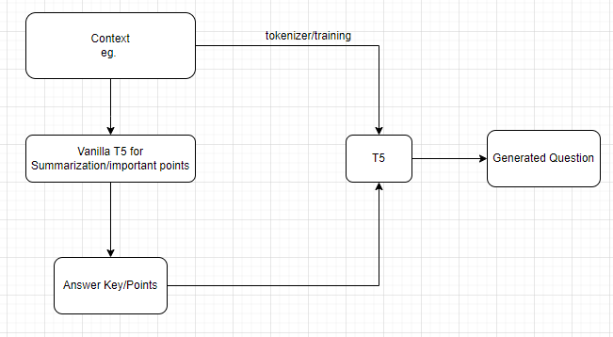
System Description

Slide 15
Hardware & Software Requirements
Hardware:
I3 processor-based computer or higher
Memory: 8GB
Technology:
Pytorch
Streamlit or Gradio
Hugging Face Transformers
Platform:
● Windows
● Linux
Tools:
Visual Studio Code
Collab (24GB GPU)

Slide 16
Conclusions
With the help of the above system requirements, we would be demonstrating the project on Automated Question Generator for instructors for their assessment.

Slide 17
References
[1]Lopez, Luis Enrico, et al. "Simplifying paragraph-level question generation via transformer language models." Pacific Rim International Conference on Artificial Intelligence. Springer, Cham, 2021.
[2] Yao Zhao, Xiaochuan Ni, Yuanyuan Ding, and Qifa Ke. 2018. Paragraph-level Neural Question Generation with Maxout Pointer and Gated Self-attention Networks. In Proceedings of the 2018 Conference on Empirical Methods in Natural Language Processing, pages 3901–3910, Brussels, Belgium. Association for Computational Linguistics.
[3]G. Kumar, R. E. Banchs and L. F. D'Haro, "Automatic fill-the-blank question generator for student self-assessment," 2015 IEEE Frontiers in Education Conference (FIE), 2015, pp. 1-3, doi: 10.1109/FIE.2015.7344291.
[4] https://cft.vanderbilt.edu/guides-sub-pages/blooms-taxonomy/
(accessed on 5/08/2022 2:45pm)

Slide 18
Questions??
Thank You!

